Slide 1
X Education - Lead Scoring Case Study
PRATIKSHA SHIRWALE

Slide 2
Problem Statement
An education company named X Education sells online courses to industry professionals. On any given day, many professionals who are interested in the courses land on their website and browse for courses.
The company markets its courses on several websites and search engines like Google. Once these people land on the website, they might browse the courses or fill up a form for the course or watch some videos. When these people fill up a form providing their email address or phone number, they are classified to be a lead. Moreover, the company also gets leads through past referrals. Once these leads are acquired, employees from the sales team start making calls, writing emails, etc. Through this process, some of the leads get converted while most do not. The typical lead conversion rate at X education is around 30%. Now, although X Education gets a lot of leads, its lead conversion rate is very poor. For example, if, say, they acquire 100 leads in a day, only about 30 of them are converted. To make this process more efficient, the company wishes to identify the most potential leads, also known as ‘Hot Leads’. If they successfully identify this set of leads, the lead conversion rate should go up as the sales team will now be focusing more on communicating with the potential leads rather than making calls to everyone. There are a lot of leads generated in the initial stage (top) but only a few of them come out as paying customers from the bottom. In the middle stage, you need to nurture the potential leads well (i.e. educating the leads about the product, constantly communicating etc. ) in order to get a higher lead conversion.

Slide 3
GOALS OF THE CASE STUDY
Build a logistic regression model to assign a lead score between 0 and 100 to each of the leads which can be used by the company to target potential leads. A higher score would mean that the lead is hot, i.e. is most likely to convert whereas a lower score would mean that the lead is cold and will mostly not get converted.
2. There are some more problems presented by the company which your model should be able to adjust to if the company's requirement changes in the future so you will need to handle these as well. These problems are provided in a separate doc file. Please fill it based on the logistic regression model you got in the first step. Also, make sure you include this in your final PPT where you'll make recommendations.

Slide 4
Lead – Conversion Process
Lead Generation:
1. Ads on websites like Google
2. Referrals
Visit to X Education website by these potential customers (professionals)
Visitors either provide Email id & Contact Details
Or
View videos etc
Tele calling and Emailing activity to all the leads
~30% leads get converted
Lead to Conversion process
Proposed Solution:
A model to filter leads so that leads to conversion ratio is 80%+

Slide 5
Proposed Solution
Selection of Hot Leads
Communicating with Hot Leads
Conversion of Hot Leads
Leads Clustering
We cluster the leads into certain categories based on their tendency or probability to convert, thus, getting a smaller section of hot leads to focus more on.
Focus Communication
Since we would have a smaller set of leads to have communication with, we might make more impact with effective communication.
Increase conversion
Since we focussed on hot leads, which were more probable to convert, we would have a better conversion rate, and hence we can achieve the 80% target.

Slide 6
Solution
For our Problem Solution, the crucial part is to accurately identify hot leads.
The more accurate we obtain the hot lead, the more chance we get of higher conversion ratio.
Since we have a target of 80% conversion rate, we would want to obtain a high accuracy in obtaining hot leads.

Slide 7
Data Gathering
Data Cleaning
Performing EDA
Data Preparation
Model Building
implementation
Loading & Observing the past data provided by the Company
Univariate, Bivariate, and Heatmap for numerical and categorical columns
Performing pre-requisites for RFE and Logistic Regression
Duplicate removal, null value treatment, unnecessary column elimination, etc.
Outlier Treatment, Feature-Standardization

Slide 8
Feature Selection
Model Building
Model Improvement
Final Model
Verifying with PCA
Selection of top 25 features using RFE
Reduction of columns and Model re-building
Verifying our Final Model Accuracy etc. with model built with PCA
Model building using RFE for selected columns
Final Model Analysis and performance on Test Data

Slide 9
PLOTS

Slide 10
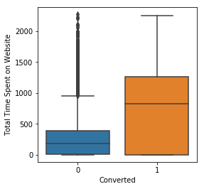
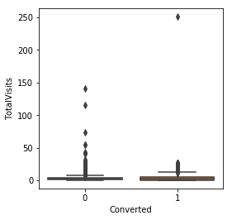
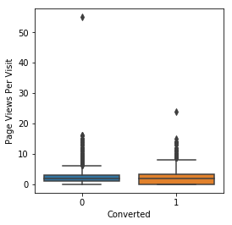
EDA plots depicting variation in numerical columns for those who Converted and those who didn't.

Slide 11
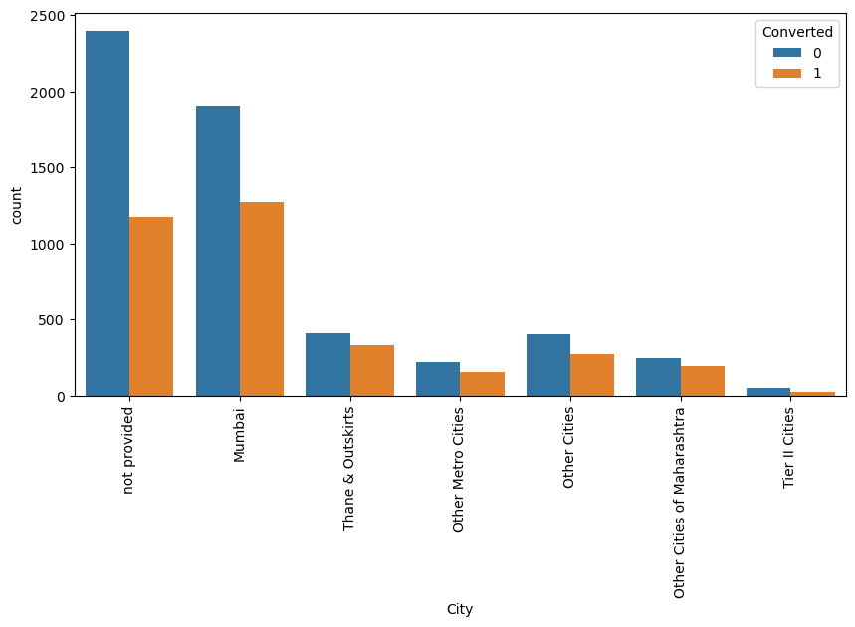
Spread of Cities

Slide 12
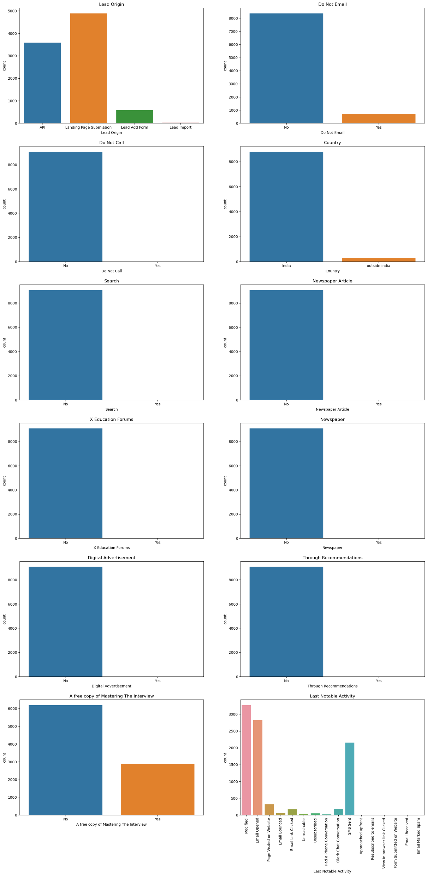
Observations

Slide 13
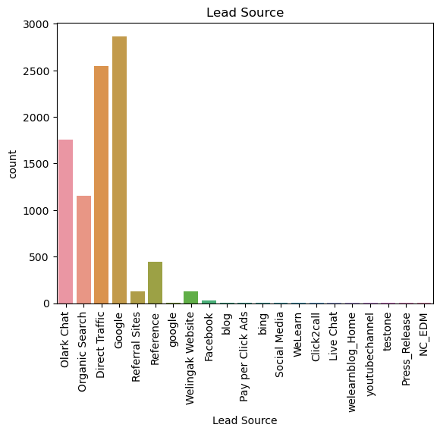
Lead Source

Slide 14
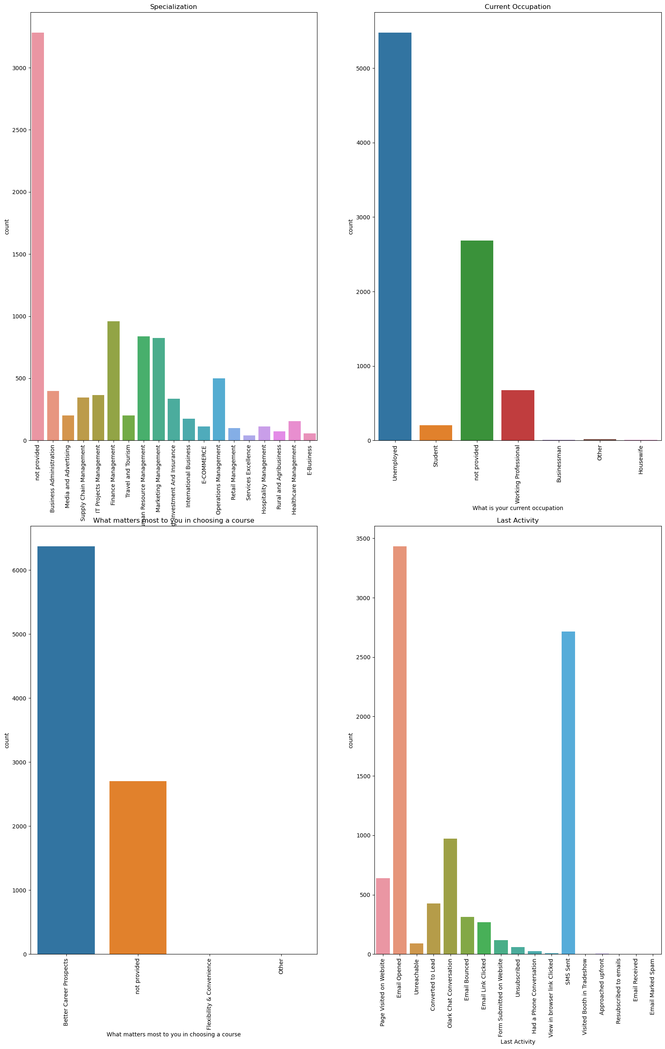

Slide 15
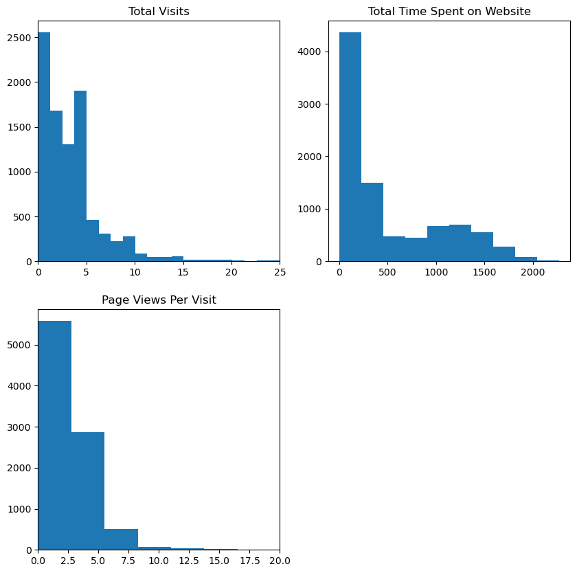

Slide 16
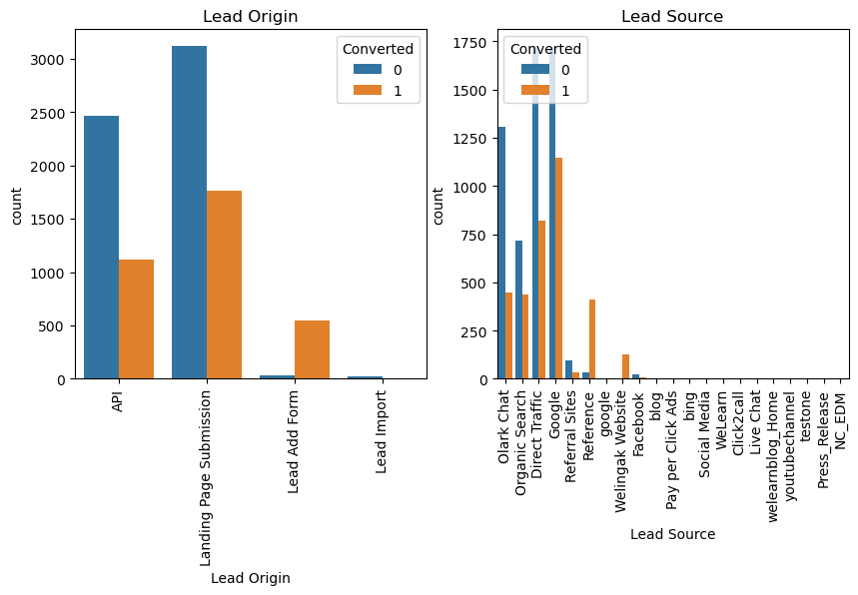

Slide 17
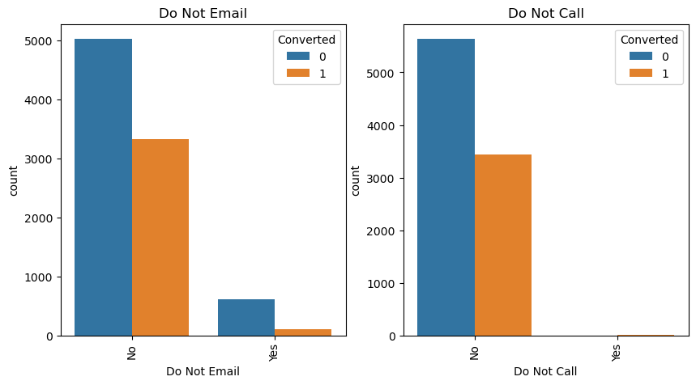

Slide 18
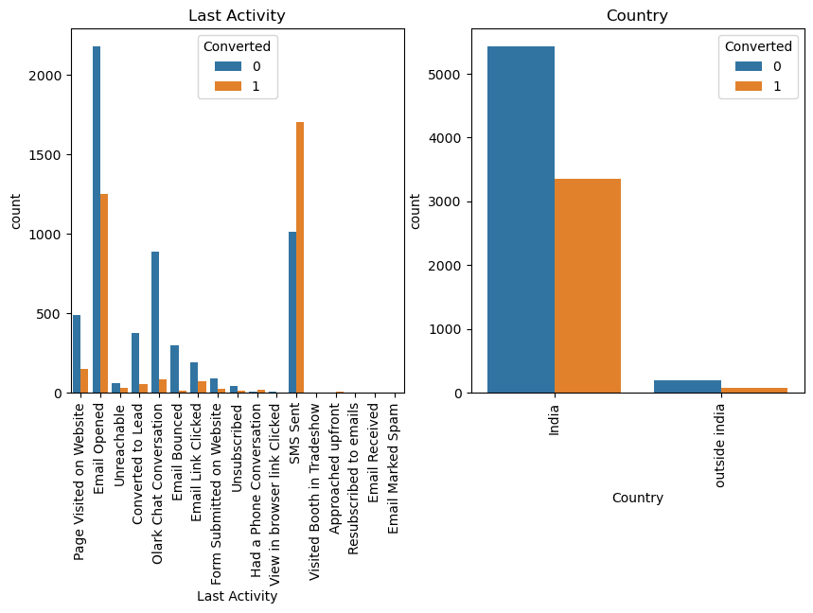

Slide 19
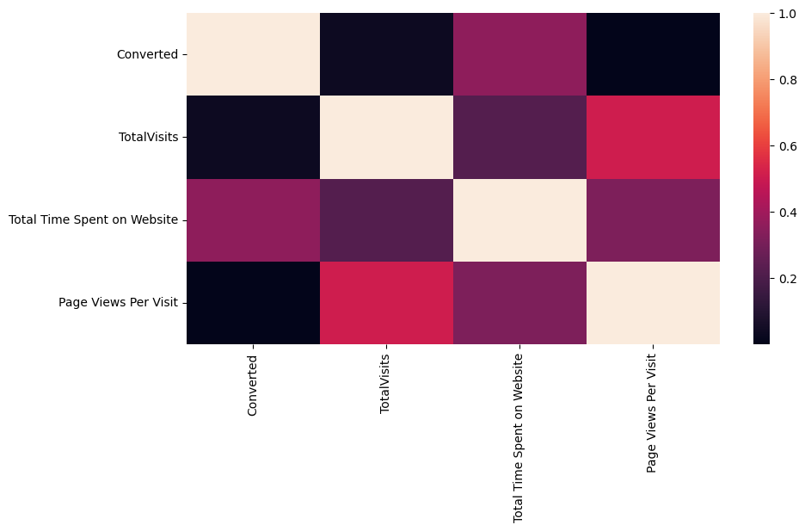

Slide 20
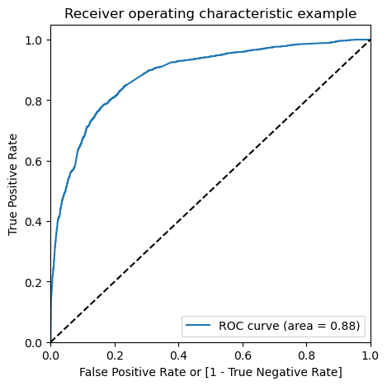
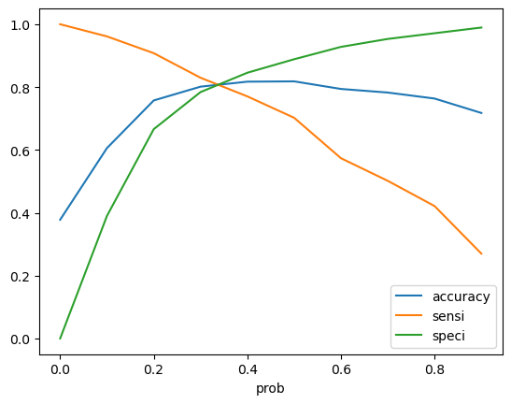
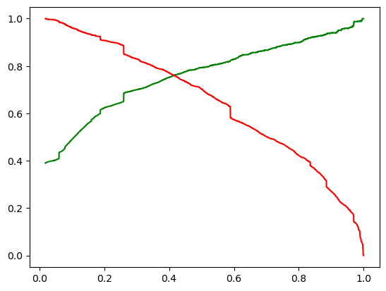
Linear Regression Final Model Parameters
Area under ROC = 0.88
Intermediate cut-off = 0.35
Final cut-off = 0.44

Slide 21
CONCLUSION
TOP VARIABLE CONTRIBUTING TO CONVERSION:
LEAD SOURCE:
Total Visits
Total Time Spent on Website
Lead Origin:
Lead Add Form
Lead source:
Direct traffic
Google
Welingak website
Organic search
Referral Sites
Last Activity:
Do Not Email_Yes
Last Activity_Email Bounced
Olark chat conversation
The Model seems to predict the Conversion Rate very well and we should be able to give the Company confidence in making good calls based on this model.

